Slide 1


Financial Plan For a young engineer
Team 6

Slide 2












AGENDA TEAM 6
Introduction
Expense Strategy
Sensitivity Analysis
Persona & Income
Conclusion

Slide 3

INTRODUCTION
A finance strategy combines financial planning with strategic planning.
A functional roadmap that assesses current resources, costs and budget and aligns them with a person’s mission and goals.
A finance strategy sets priorities, manages trade-off decisions and minimize the costs of change to effectively finance critical decisions.

Slide 4

PERSONA

Slide 5
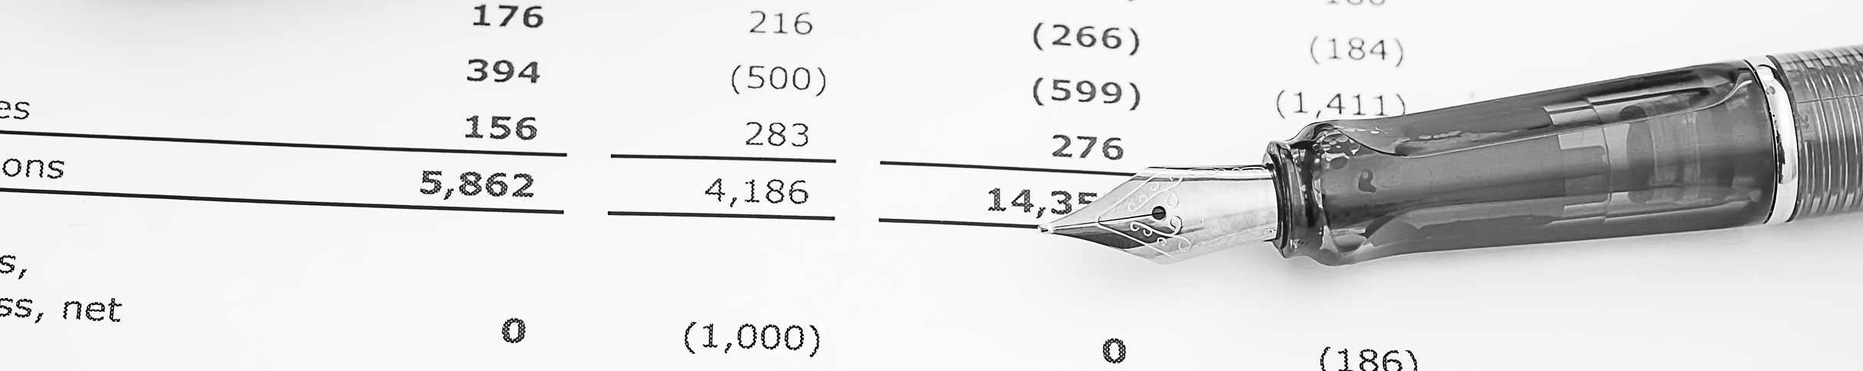
Income & Deductions
$84,000
-26%
+5%
Monthly $7000
Federal & State Tax
Annual Increment
(5% retirement fund)
Retirement fund is tax free
+5% from previous year

Slide 6
Salary Timeline
+10% increment every year
25
30
35
40
$84,000
Monthly $7000
$107,000
Monthly $8900
$136,800
Monthly $11,400
$175,000
Monthly $14,500
45
55
65
$222,800
Monthly $18,500
$363,000
Monthly $30,000
$563,000
Monthly $47,000

Slide 8

Education loan
- Undergraduate Degree
Loan Amount: $200,000
Interest Rate: 4.45%
Tenure Period: 15 years (180 Payments)
Monthly EMI Amount: $1990.57
- Graduate Degree
Loan Amount: $50,000
Interest Rate: 5.28%
Tenure Period: 15 years (180 Payments)
Monthly EMI Amount: $447.48

Slide 9



Transportation
1st Car | 2nd car | 3rd car
Condition: Used | New | New
Will Own for: 5 years (from age 25) | 20 years | 15 years
Cost: $15500 | $50000 | $60000
Loan period: 2 years | 3 years | 5 years
Monthly Interest rate: 0% (graduation gift) | 5.99%/12 | 8%/12
O&M Cost (Monthly): $150 | $2 monthly increase | $200 | $3 increase every 3 months | $300 | $5 increase every 3 months
Salvage value: $0 (handed down to sibling) | $5000 | $7000

Slide 10
Case 1:
Car 1 for 5 years. Purchase at 25, sell at 30.
Car 2 for 15 years. Purchase at 30, sell at 45.
Car 3 for 20 years. Purchase at 45, sell at 65 (retirement).
Case 2:
Keep the second car for 20 years (5 more years than in the previous case), then purchase the third car.
Car 1 for 5 years. Purchase at 25, sell at 30.
Car 2 for 20 years. Purchase at 30, sell at 50.
Car 3 for 15 years. Purchase at 50, sell at 65 (retirement).
Note: In both cases, it is assumed that the same cars will be purchased at the same price and the same loan plans will be followed for the respective cars.
Case 2 has a lower overall O&M Cost

Slide 11
Higher payments occur later in Case 2, making it more preferrable

Slide 12



Stocks
Stocks
INVESTMENT BREAKDOWN
INVESTED : $108000
$100 monthly until 30 years
$200 monthly until 50 years
$300 monthly until 65 Years
WORTH : $1293986
PROFIT : $1283186
PROFIT
For the first 9 years 12%/year/monthly
From 11 to 14 years 12%/year/monthly
From 16 to 19 years 24%/year/monthly
From 21 to 40 years 36%/year/monthly

Slide 13
Stock appreciation value

Slide 14



Living Expenses
House Rent – $750 monthly
Increases yearly – 6%
Food & Utilities – $600 monthly
Increases yearly – 3.06%

Slide 15

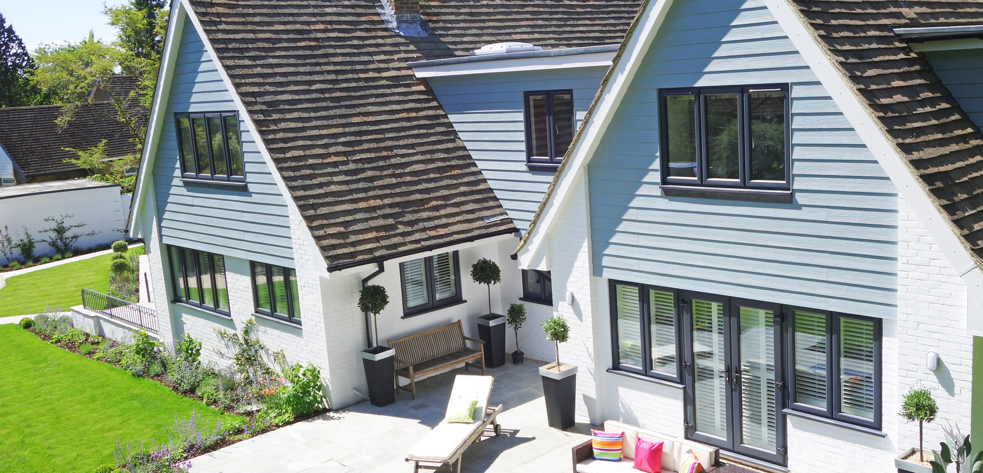
BUY A HOUSE
Cost - $500,000
Down payment – $50,000
Loan amount – $450,000
Loan tenure – 20 yrs.
Interest rate – 6.282%
Mortgage EMI – 450000 (A|P, 6.282%/12, 240) – $941.825
Future Worth
Household prices increase at an average rate of 4.4% per year
Book Value after 27 yrs. 500,000(F|P, 4.4%, 27)
$1,599,130

Slide 16
Total Savings

Slide 17
Sensitivity Analysis

Slide 18
Sensitivity Analysis

Slide 19
Sensitivity Analysis

Slide 20


